Slide 1




Slide 2
FHIR Deep Dive

Slide 3
Getting Started: HL7 Community

Slide 4
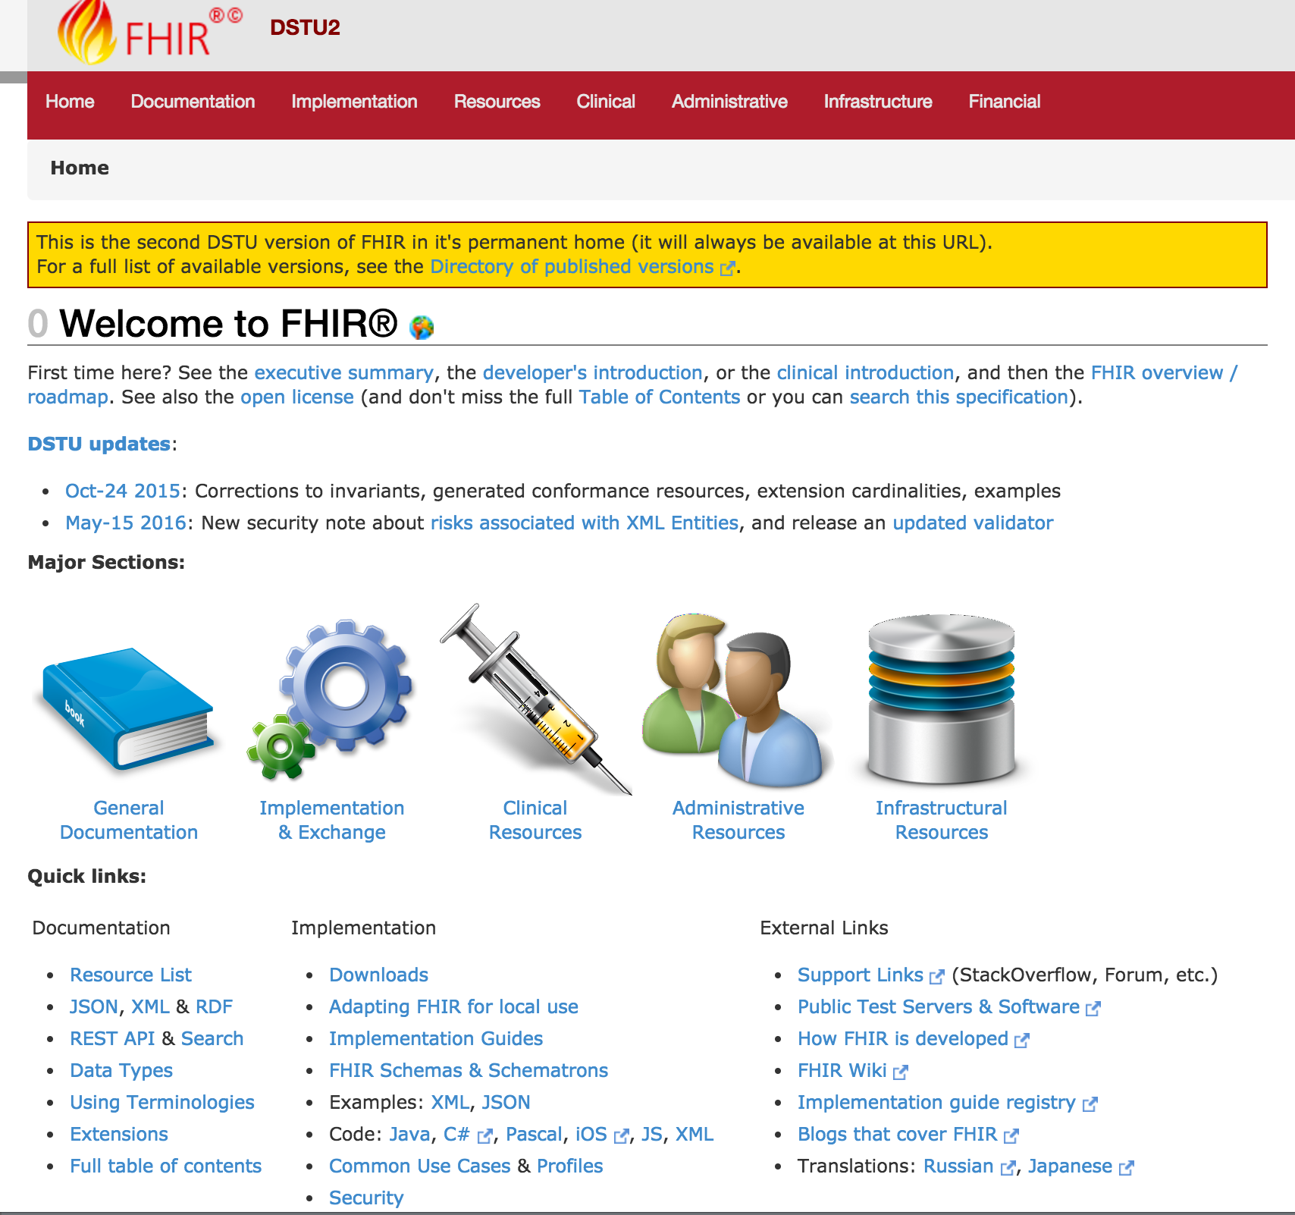




Versioning
Introductions
Support
Cheatsheets & Info
Updates
http://hl7.org/fhir/dstu2/index.html

Slide 5
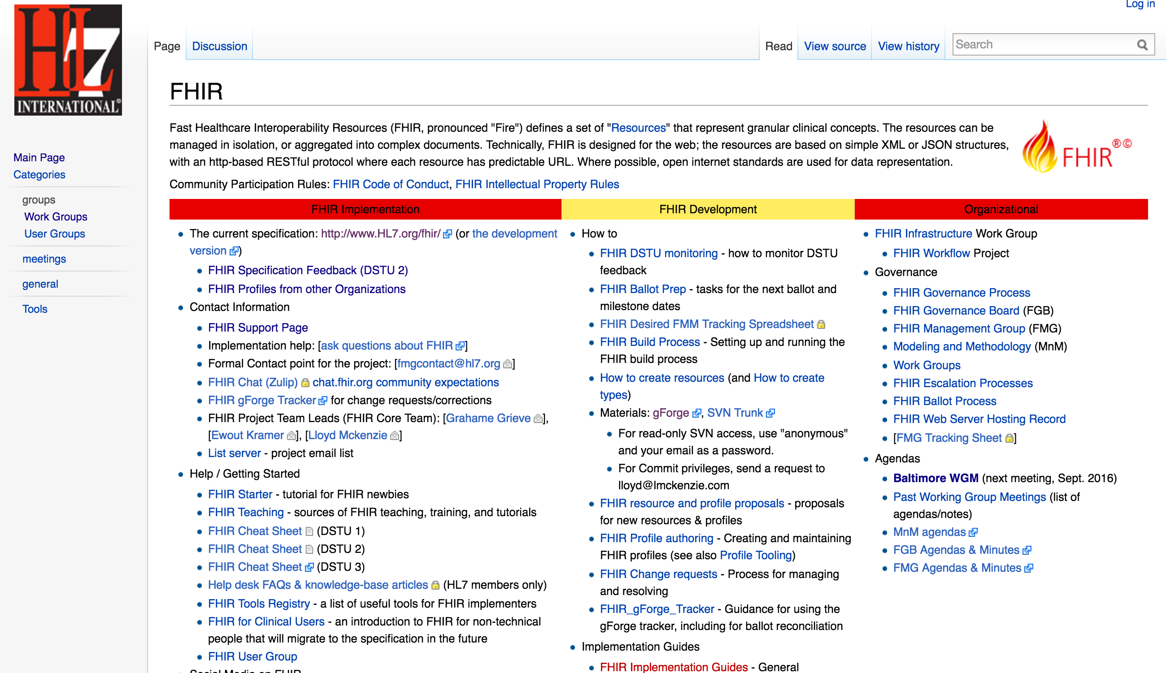
Getting Started
http://wiki.hl7.org/index.php?title=FHIR

Slide 6



Note: HAPI is the recommended Java Reference implementation
http://hapifhir.io/index.html
Resources
Spec Details
Reference Libraries

Slide 7
Getting Started: Cerner Community

Slide 8


code.cerner.com

Slide 9
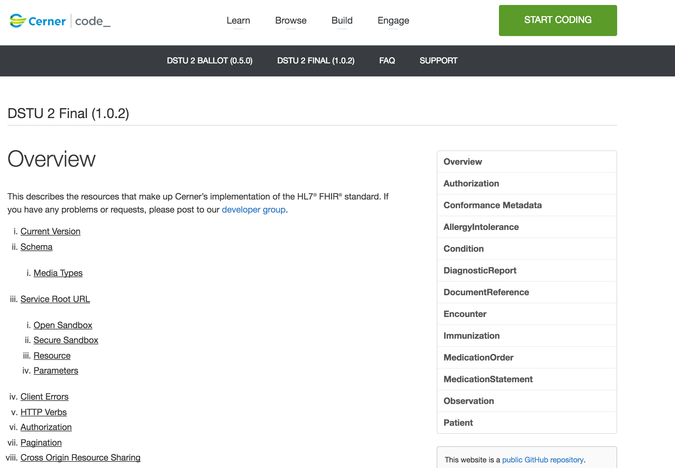



Versions
Resources
Sandbox

Slide 10
Specification Versioning

Slide 11
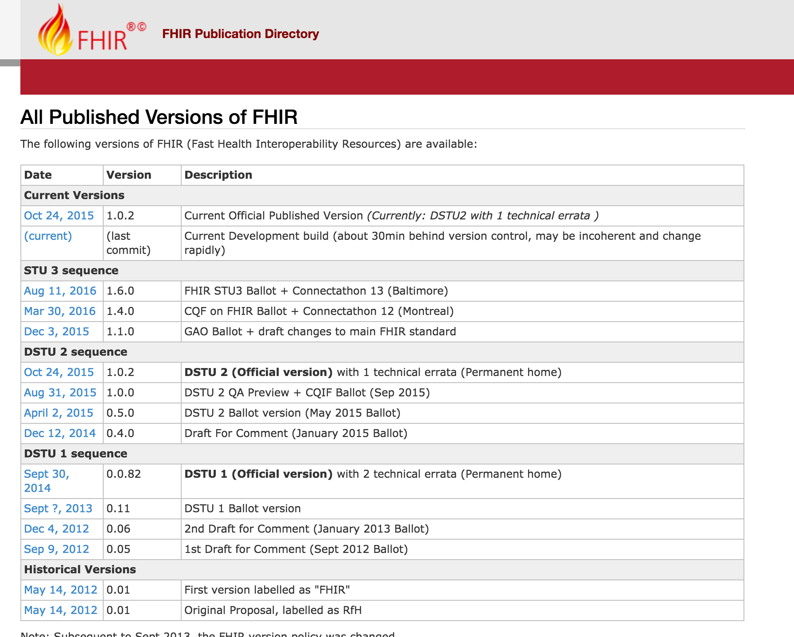
Current: DSTU2
AKA: 1.0.2
http://hl7.org/fhir/directory.html

Slide 12
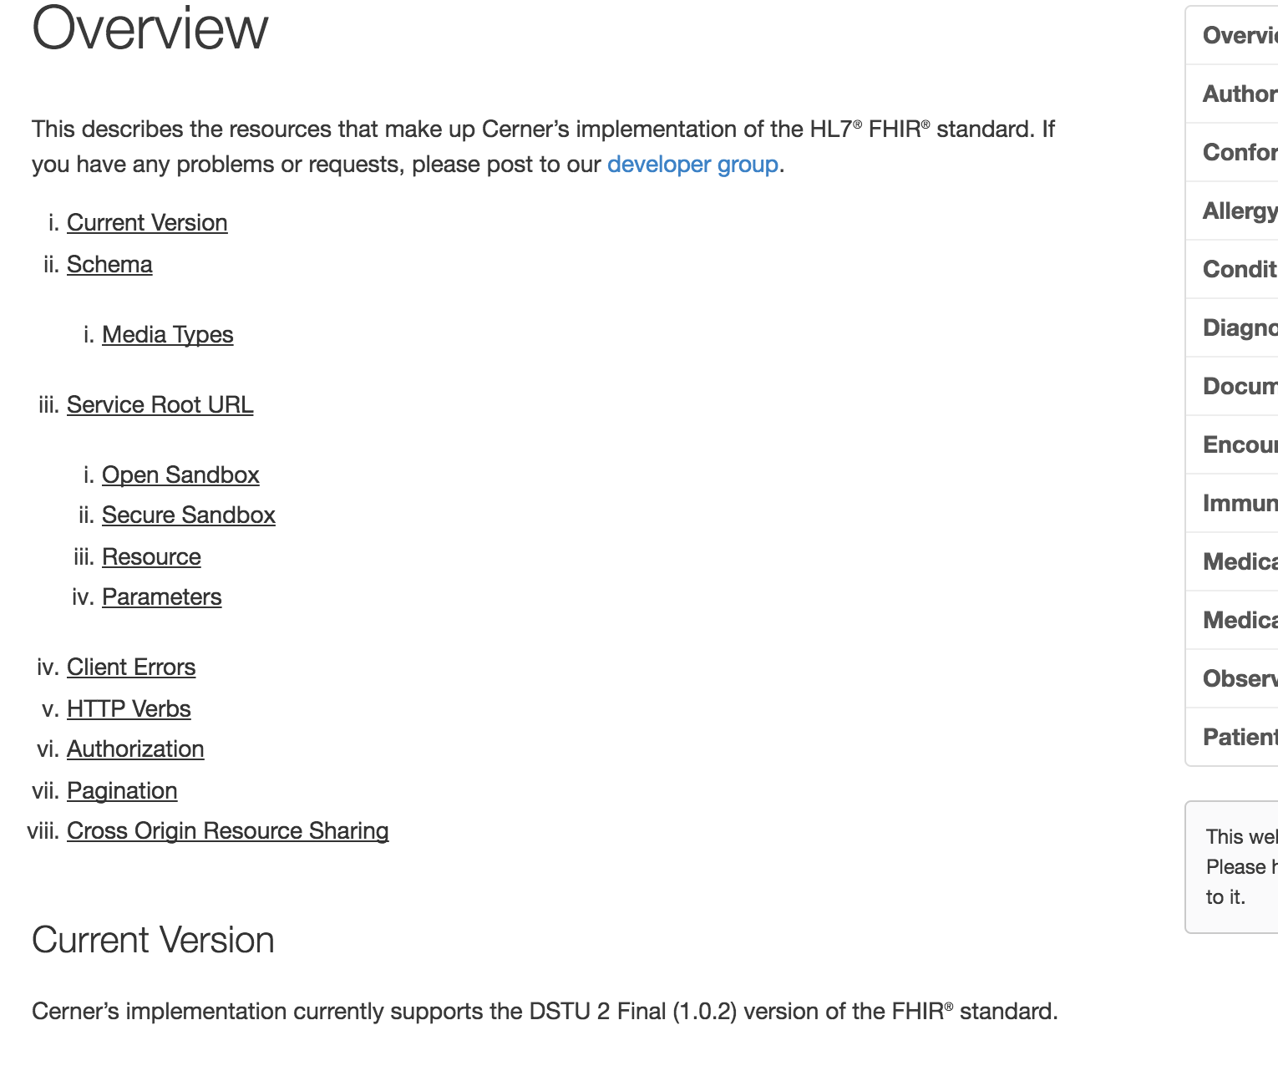
Latest Millennium Production: DSTU2/1.0.2
http://fhir.cerner.com/dstu2/

Slide 13

Which Version?
Multiple Available
Deprecate Oldest
Time to Uplift Applications

Slide 14
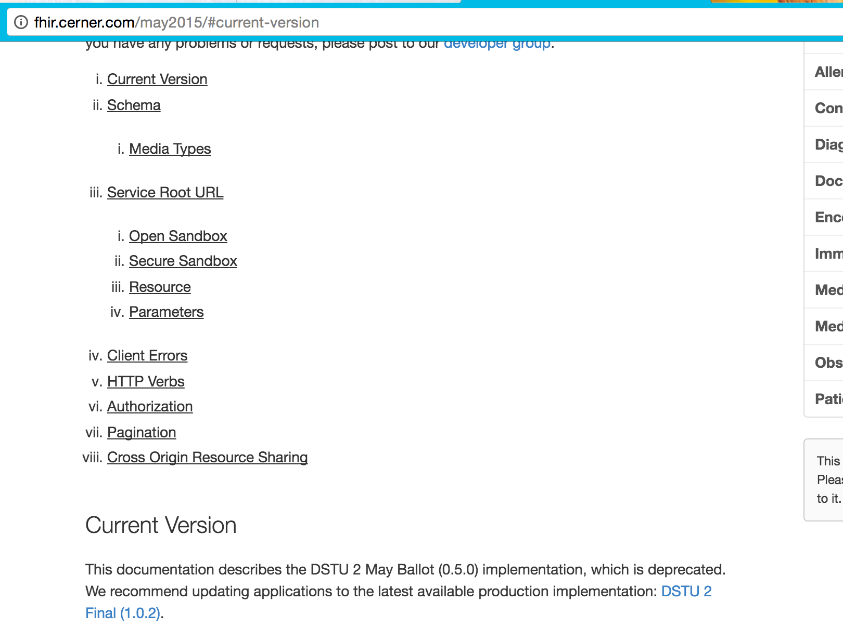
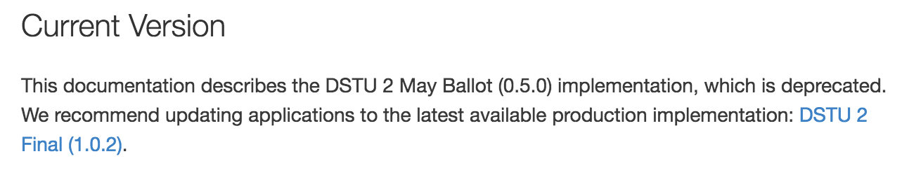
http://fhir.cerner.com/may2015/

Slide 15
Data Types

Slide 16
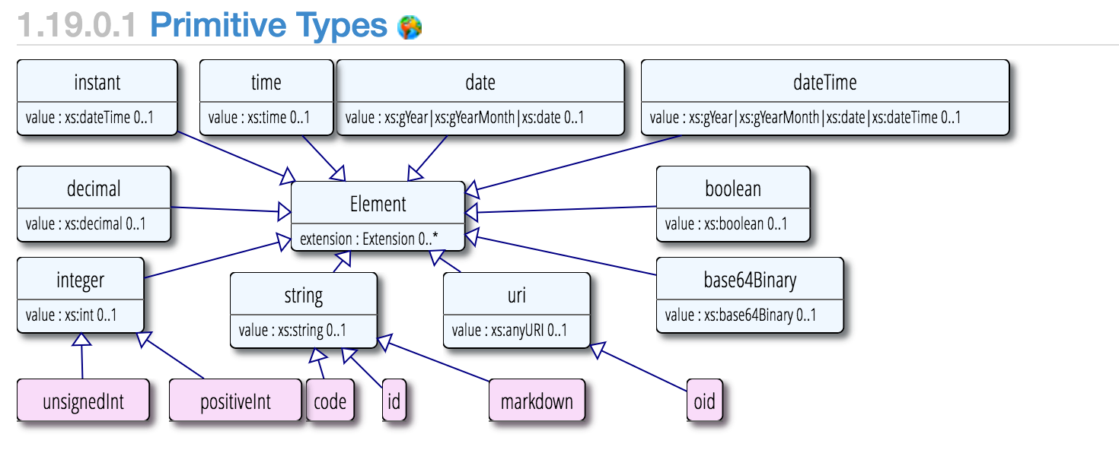
Primitive Types
http://hl7.org/fhir/dstu2/datatypes.html#primitive

Slide 17
Surprises
Decimal: 1.01, 1.010
Instant vs DateTime
DateTime vs Date vs Time
Notes:
Decimals, precision matters (e.g.: use big decimal)
Instant is for machines, DateTime is for humans. Instant MUST have seconds and zone.
DateTime is year, year/month, year/month/day, year/month/day/time (must have zone if there’s a time). Seconds are required (XML definition/schema), but can be ignored or zero.
Date is year, year/month, year/month/day
Time is zone-less, dateless (see you at 8:00 AM every day)

Slide 18
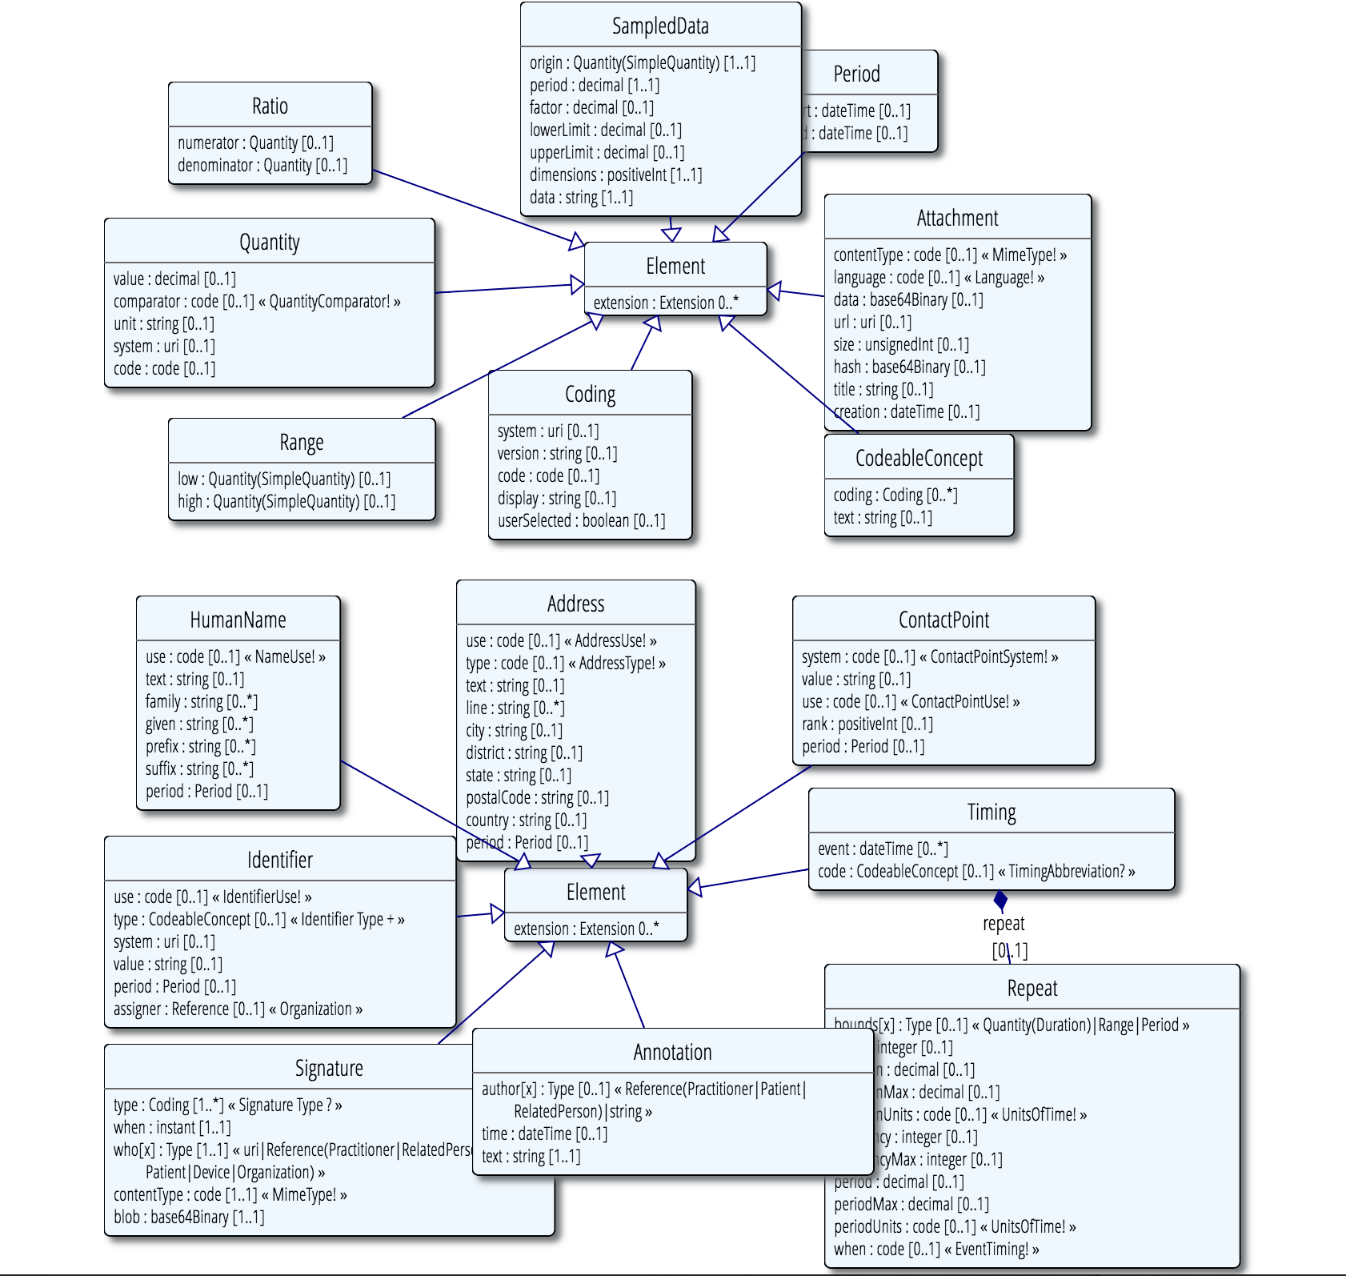
Complex Types
http://hl7.org/fhir/dstu2/datatypes.html#complex

Slide 19
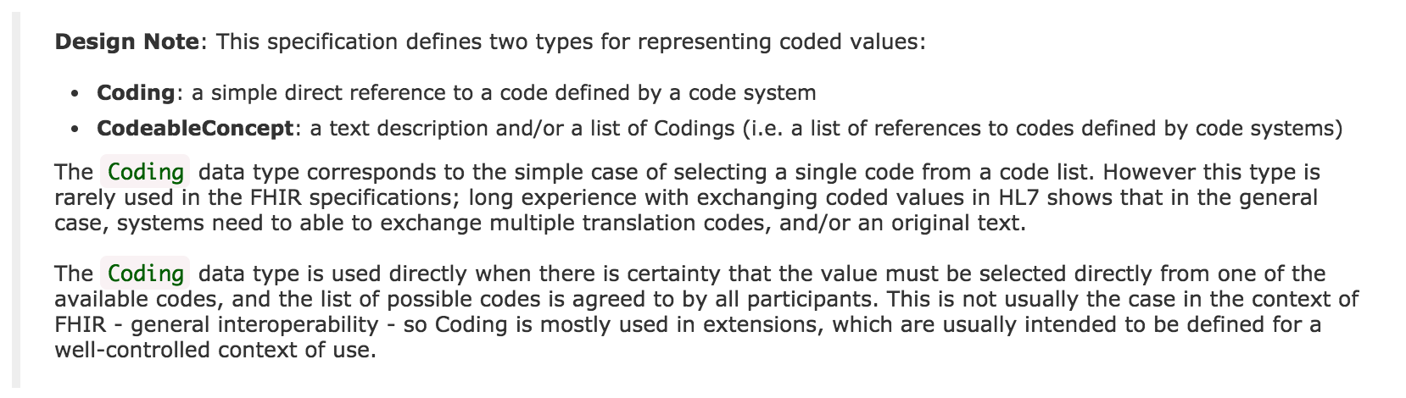
Code Systems
http://hl7.org/fhir/dstu2/datatypes.html#codesystem
Notes:
Code: codified value (usually from a set of values) to represent a concept.
Coding: Code + meta data (e.g., system, version)
CodeableConcept allows you to choose a list of codes, e.g.: multiple terminologies
CodeableConcept references Coding, Coding references a Code.
Code: m, f, unk
Coding: m, + system
CodeableConcept: Relationship type for patient contacts, Observation type (e.g.: height/weight, Loinc, SNOMED)

Slide 20
Formats
JSON and/or XML
Via Accept or Content-Type headers
Via _format parameter
http://hl7.org/fhir/dstu2/http.html#mime-type

Slide 21
Resources

Slide 22
Resources
Patient, Condition, MedicationOrder…
All resources have metadata
All resources have narrative
Structured data items
[base]/[Resource] (case sensitive)
[base]/Patient
http://hl7.org/fhir/dstu2/resource.html

Slide 23
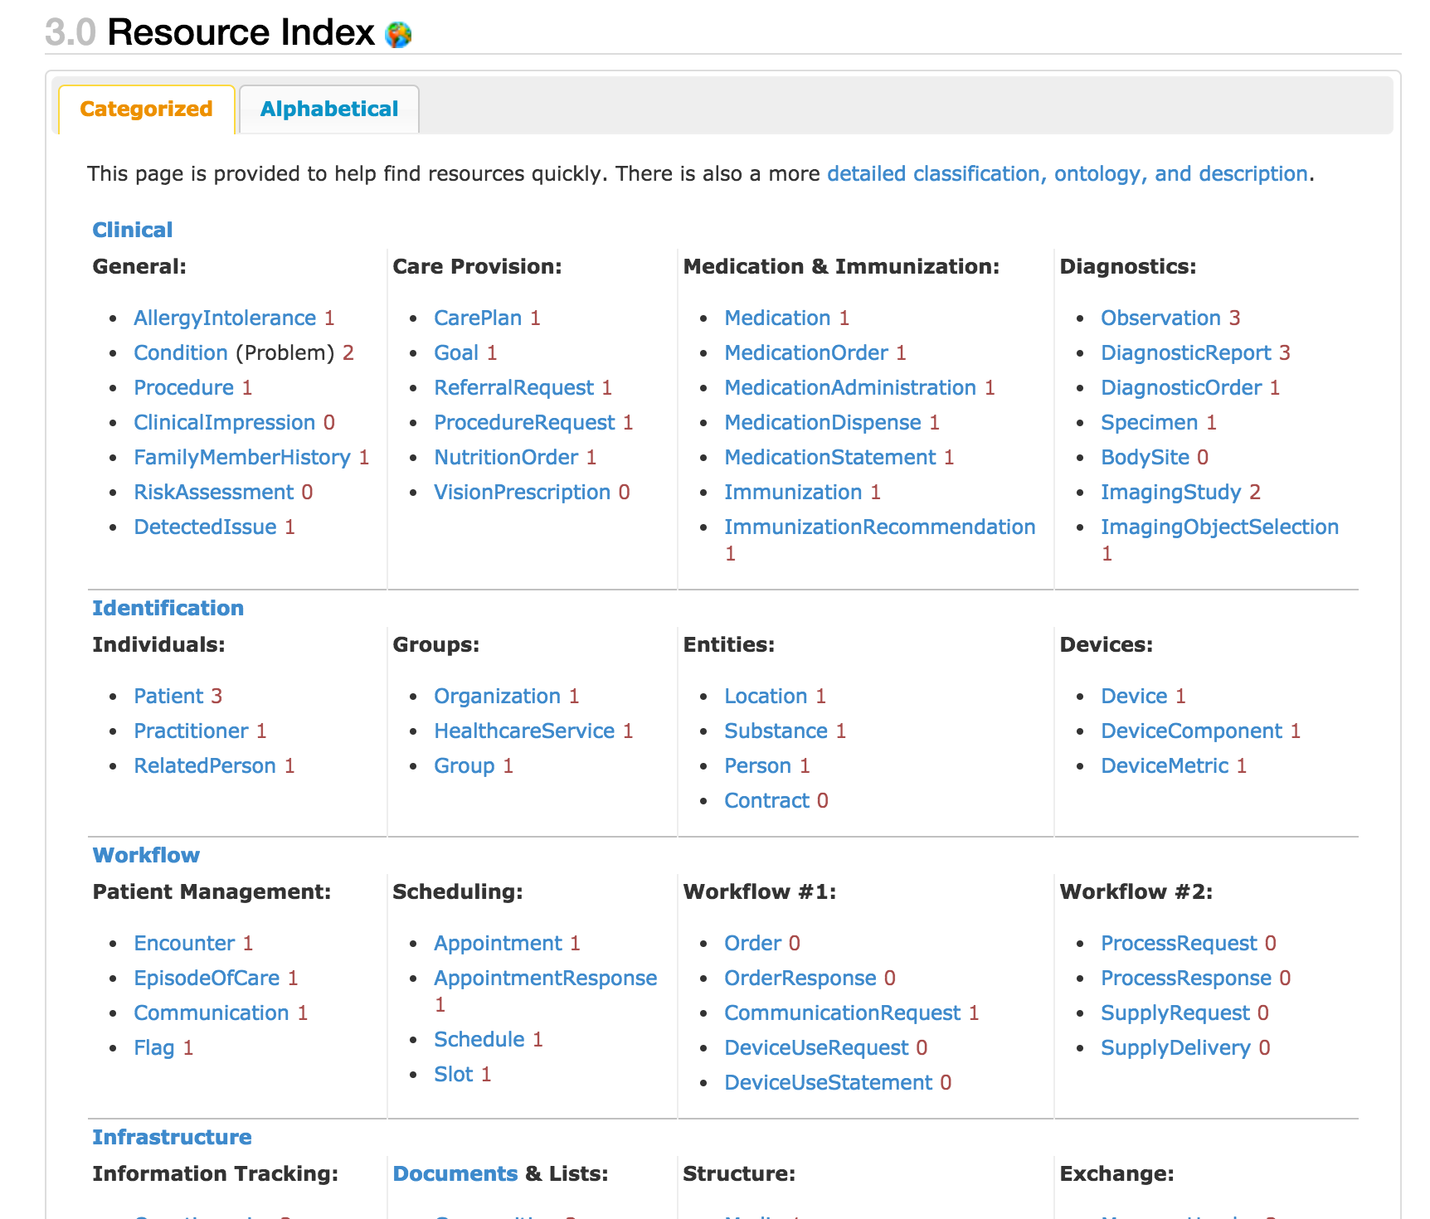
http://hl7.org/fhir/dstu2/resourcelist.html
Notes:
That number to the side…?

Slide 24
Maturity Levels
Risk for change
Lower number, highest risk
0-5
http://hl7.org/fhir/dstu2/resource.html#maturity
Notes:
If you are adverse to change, choose 4+
… which doesn’t exist in DSTU 2

Slide 25
Terminology Bindings

Slide 26
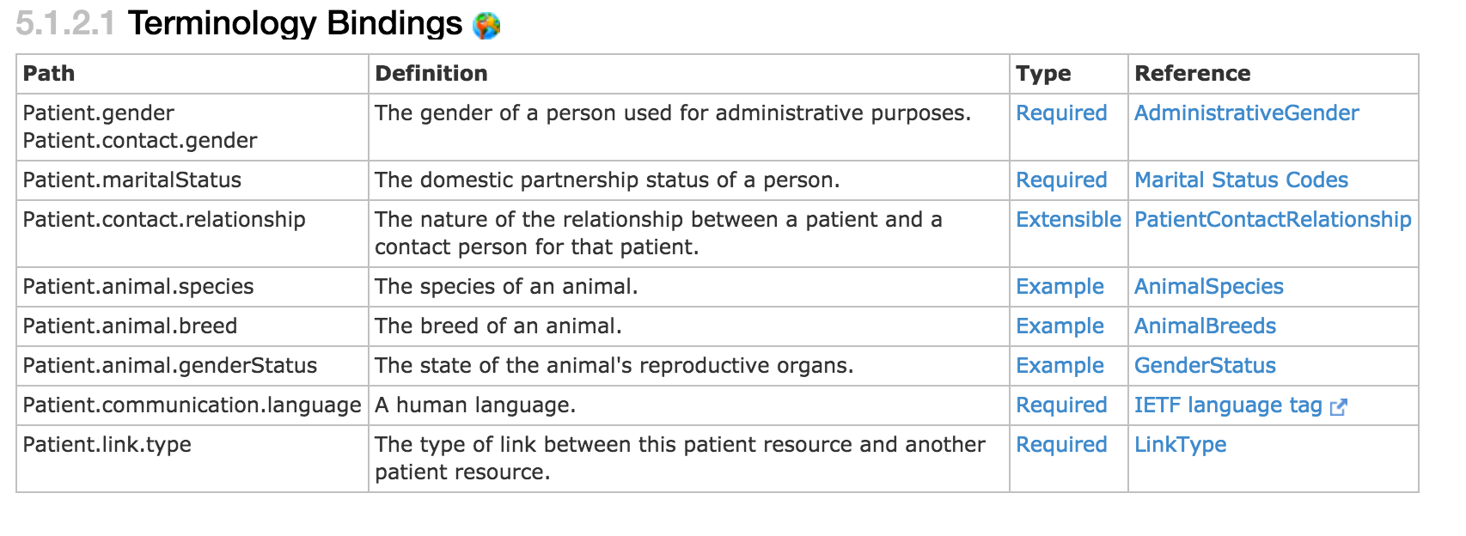
Terminology Bindings
http://hl7.org/fhir/dstu2/patient.html#tx

Slide 27
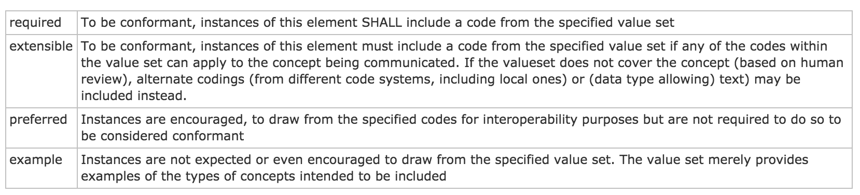
Type/Binding Strength
http://hl7.org/fhir/dstu2/terminologies.html#strength
Notes:
Required: for codeableConcept, you can’t just send “text”

Slide 28
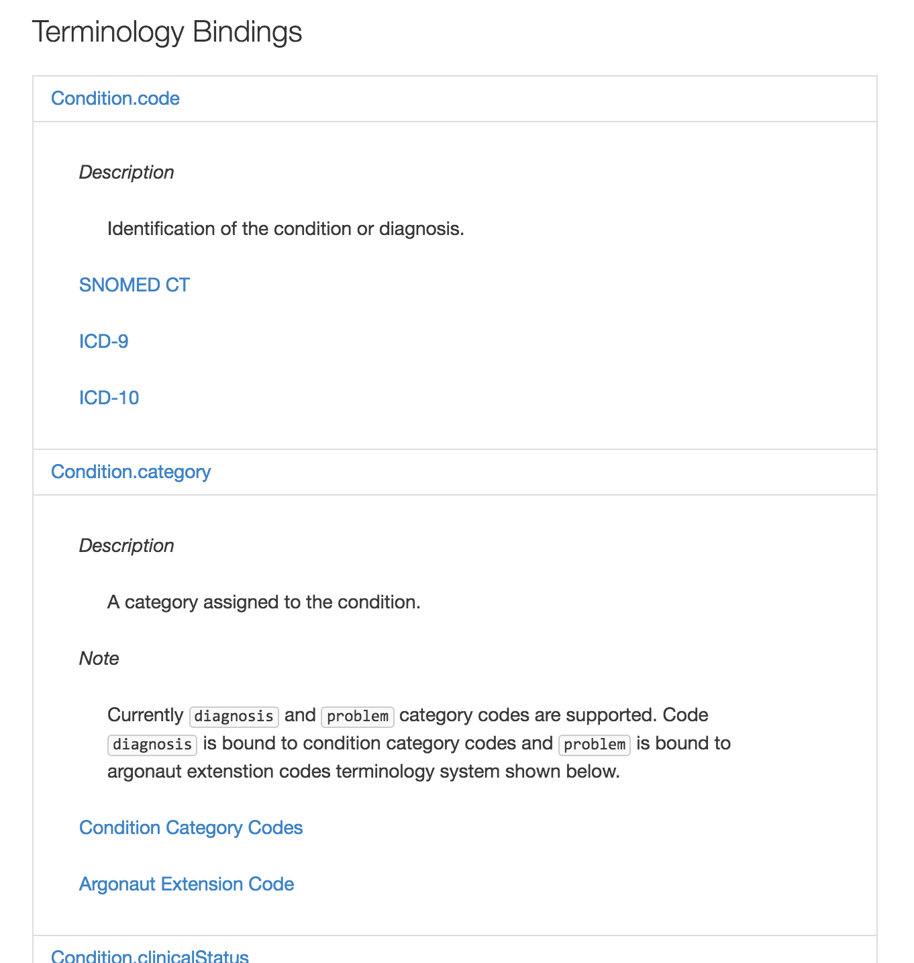
http://fhir.cerner.com/dstu2/condition/#terminology-bindings
Notes:
If a binding isn’t “required” by core spec, we’ll call out what our binding strength is in documentation

Slide 29
Narrative

Slide 30
“Any resource that is a domain resource (almost all types of resource) may include a human-readable narrative that contains a summary of the resource, and may be used to represent the content of the resource to a human. If narrative is present, it SHALL reflect all content needed for a human to understand the essential clinical and business information otherwise encoded within the resource. Resource definitions may define what content should be represented in the narrative to ensure clinical safety.”
http://hl7.org/fhir/dstu2/narrative.html#Narrative
Notes:
It is often the fall back if a client application doesn’t understand the FHIR resource in question

Slide 31
…”text”: {
"status": "generated",
"div": "<div><table><tbody><tr><td>Name</td><td>Peter James <b>Chalmers</b> (&quot;Jim&quot;)</td></tr><tr><td>Address</td><td>534 Erewhon, Pleasantville, Vic, 3999</td></tr><tr><td>Contacts</td><td>Home: unknown. Work: (03) 5555 6473</td></tr><tr><td>Id</td><td>MRN: 12345 (Acme Healthcare)</td></tr></tbody></table></div>"
}…

Slide 32
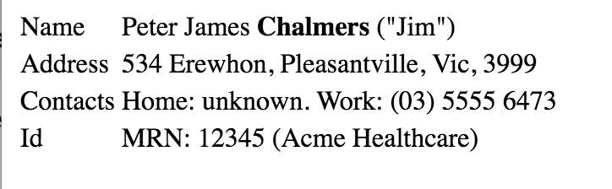

Slide 33
Read

Slide 34
Read
“By ID”
[base]/[Resource]/[id]
[base]/Patient/123ABC
http://hl7.org/fhir/dstu2/http.html#read

Slide 35
id vs identifier
id: logical identifier, must be unique within the FHIR server and resource
identifier: business identifier or “alias”
SSN
MRN
Military ID
http://hl7.org/fhir/dstu2/resource.html#id

Slide 36
Search

Slide 37
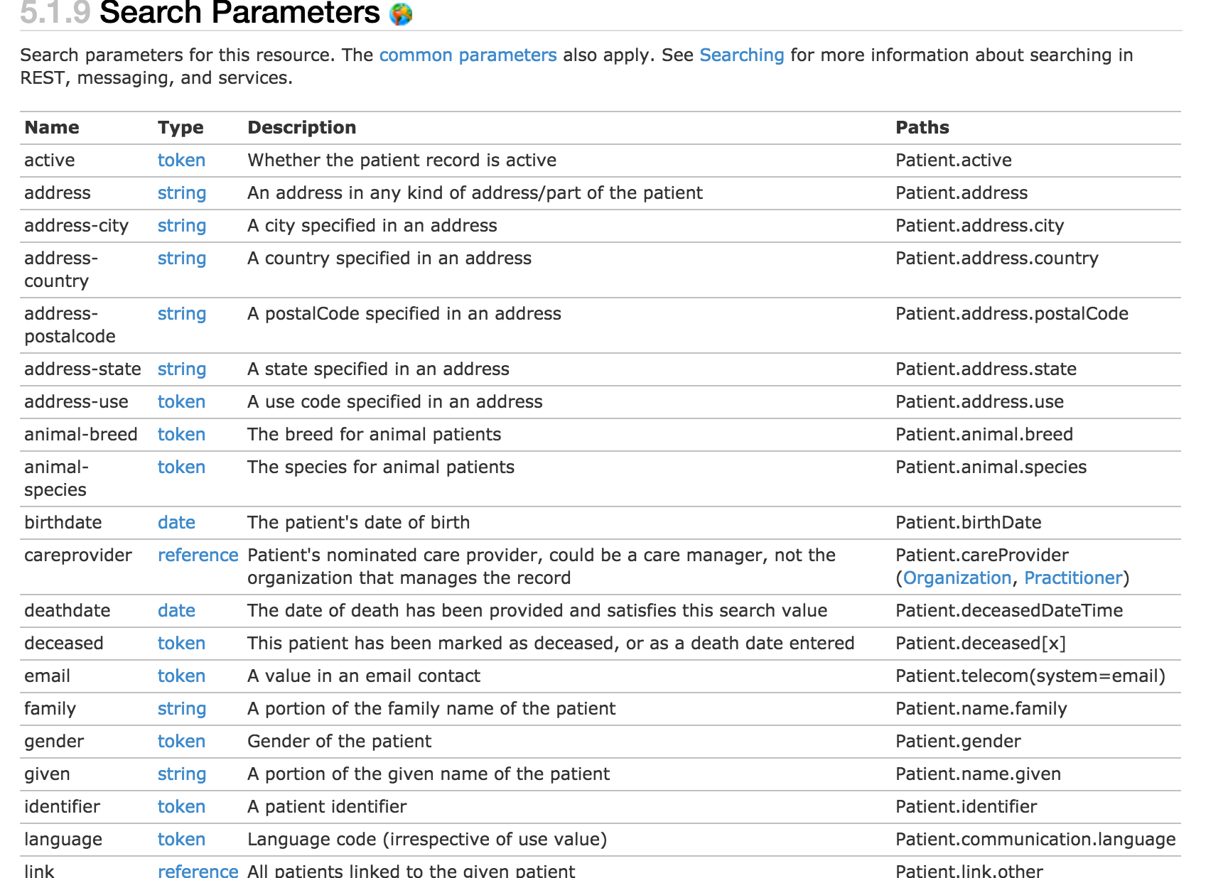
http://hl7.org/fhir/dstu2/patient.html#search

Slide 38
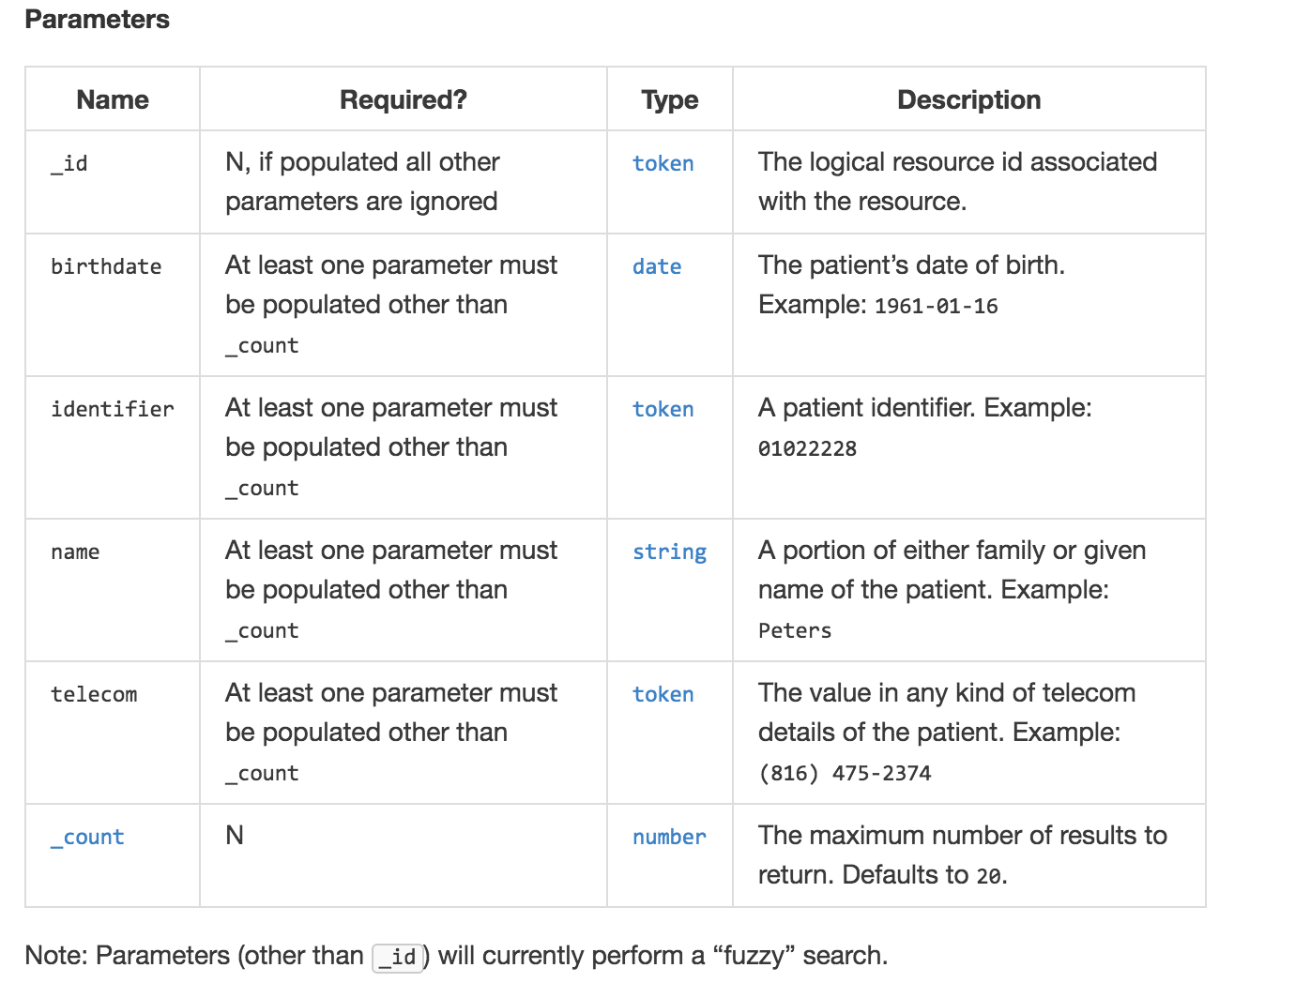
http://fhir.cerner.com/dstu2/patient/#parameters

Slide 39
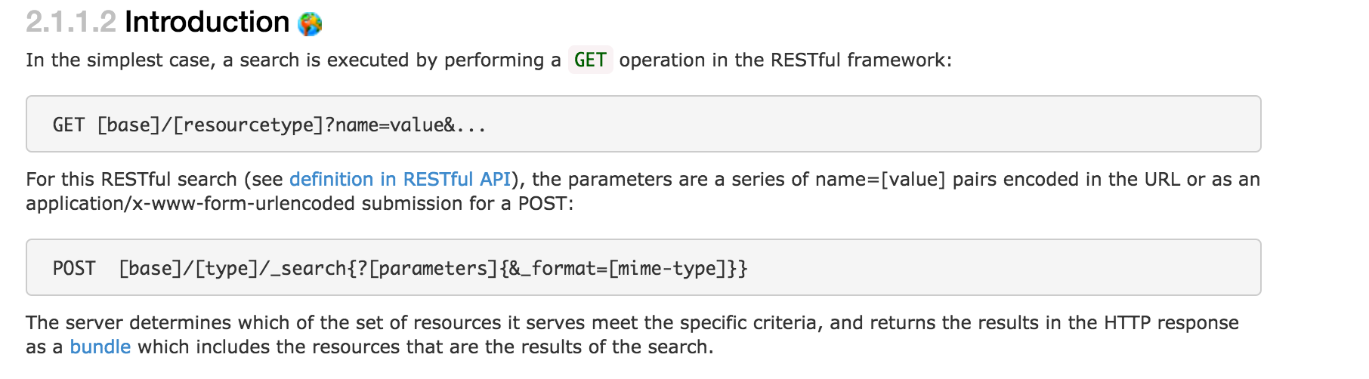
GET [base]/AllergyIntolerance?patient=123
http://hl7.org/fhir/dstu2/search.html
Notes:
This example is searching for all allergies for patient 123

Slide 40
Paging

Slide 41
Paging
Self, First, Previous, Next, Last
Must use link as provided
Changing this has undefined consequences
_count parameter
Less but not more
For interoperability - handle paging
http://hl7.org/fhir/dstu2/http.html#paging
Notes:
Handle paging in the application, which helps ensure you’re run against most servers. Check for the “next” link to see if there are additional pages.

Slide 42
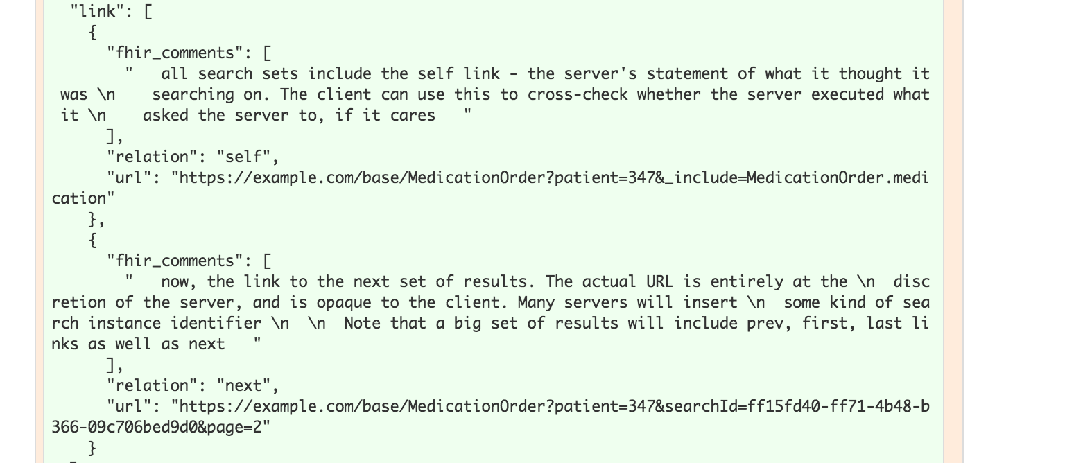
Notes:
The previous link isn’t in this example

Slide 43
Writes

Slide 44
Create
POST [base]/[Resource]
POST [base]/AllergyIntolerance
Body (content-type) must match supported FHIR format
http://hl7.org/fhir/dstu2/http.html#create

Slide 45
Update
PUT [base]/[Resource]/[id]
PUT [base]/AllergyIntolerance/123
Body (content-type) must match supported FHIR format
http://hl7.org/fhir/dstu2/http.html#update

Slide 46
Conditional Update
Optimistic Locking via “If-Match”
Example: Version in database: 2a
Version in “If-Match”: 1a - failure
Version in “If-Match”: 2a - success
http://hl7.org/fhir/dstu2/http.html#2.1.0.10.2

Slide 47
Extensions

Slide 48
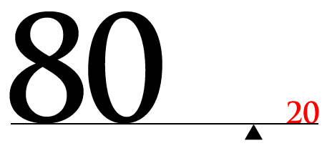
http://hl7.org/fhir/dstu2/extensibility.html

Slide 49
Extension “Rules”
They’re Expected
They can nest
Server/Client cannot reject because of extension
Unless it’s a modifier

Slide 50
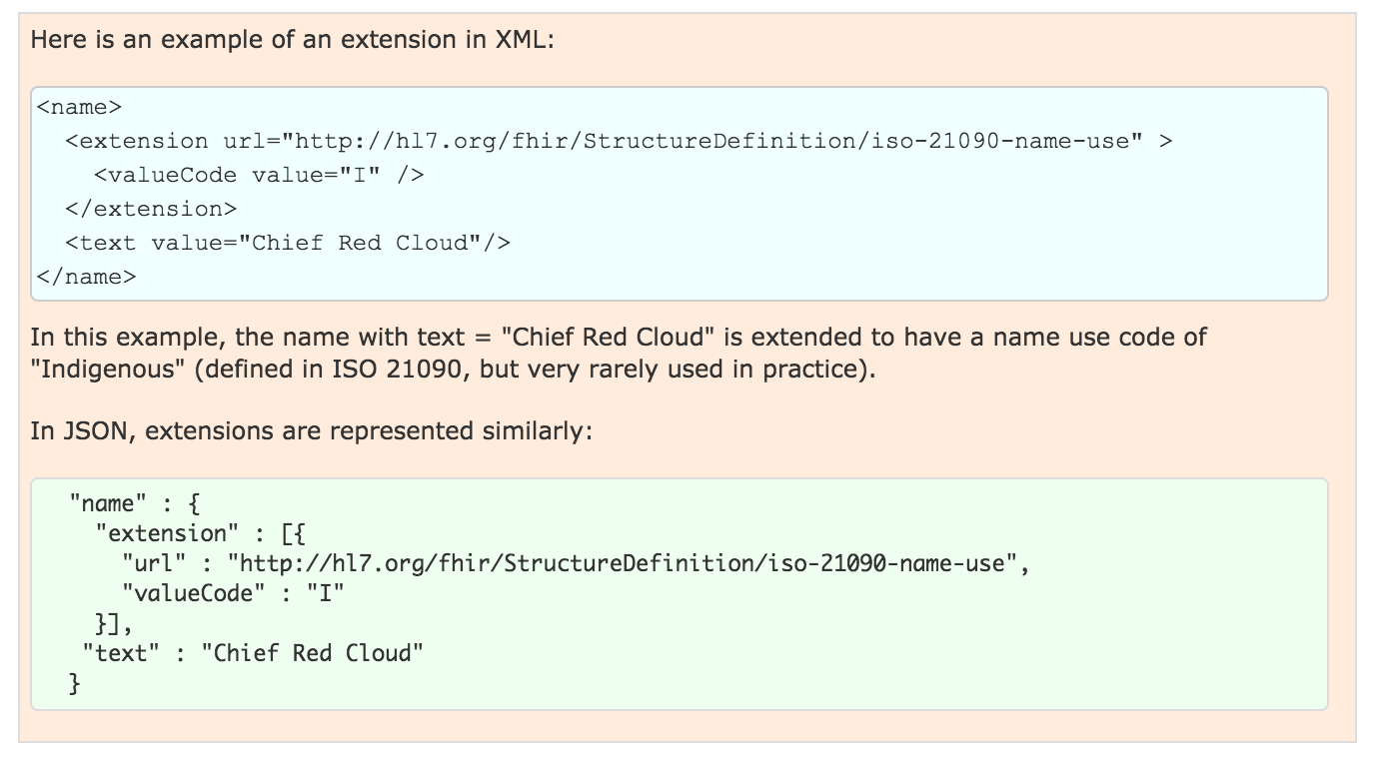
Examples

Slide 51
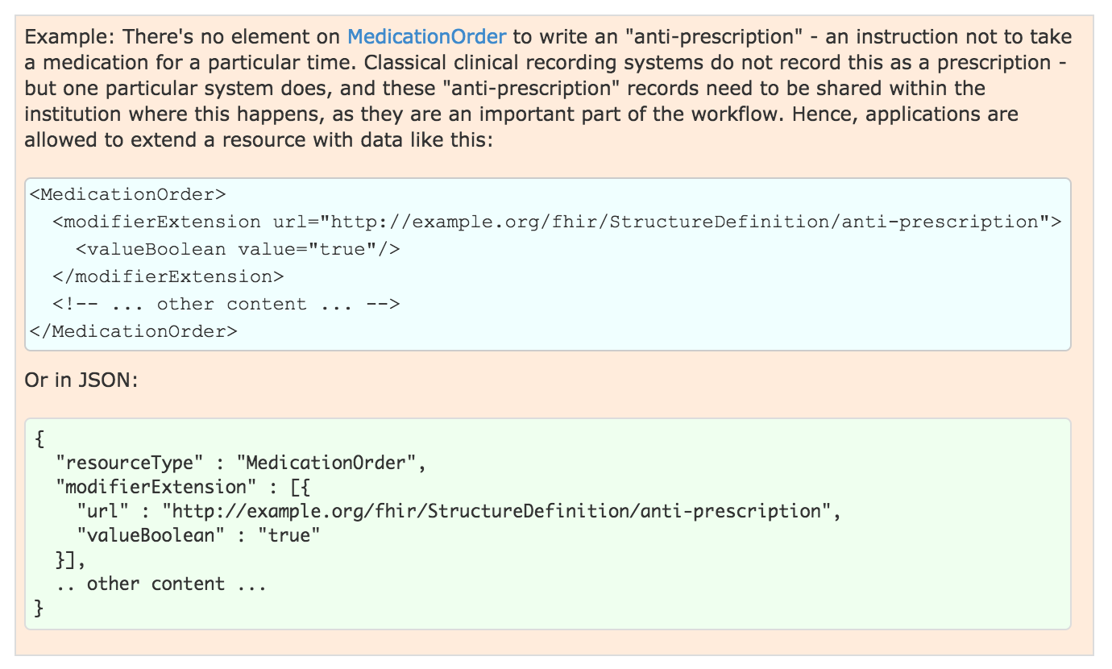
Modifier Example
Notes:
Note: this should show in the narrative

Slide 52
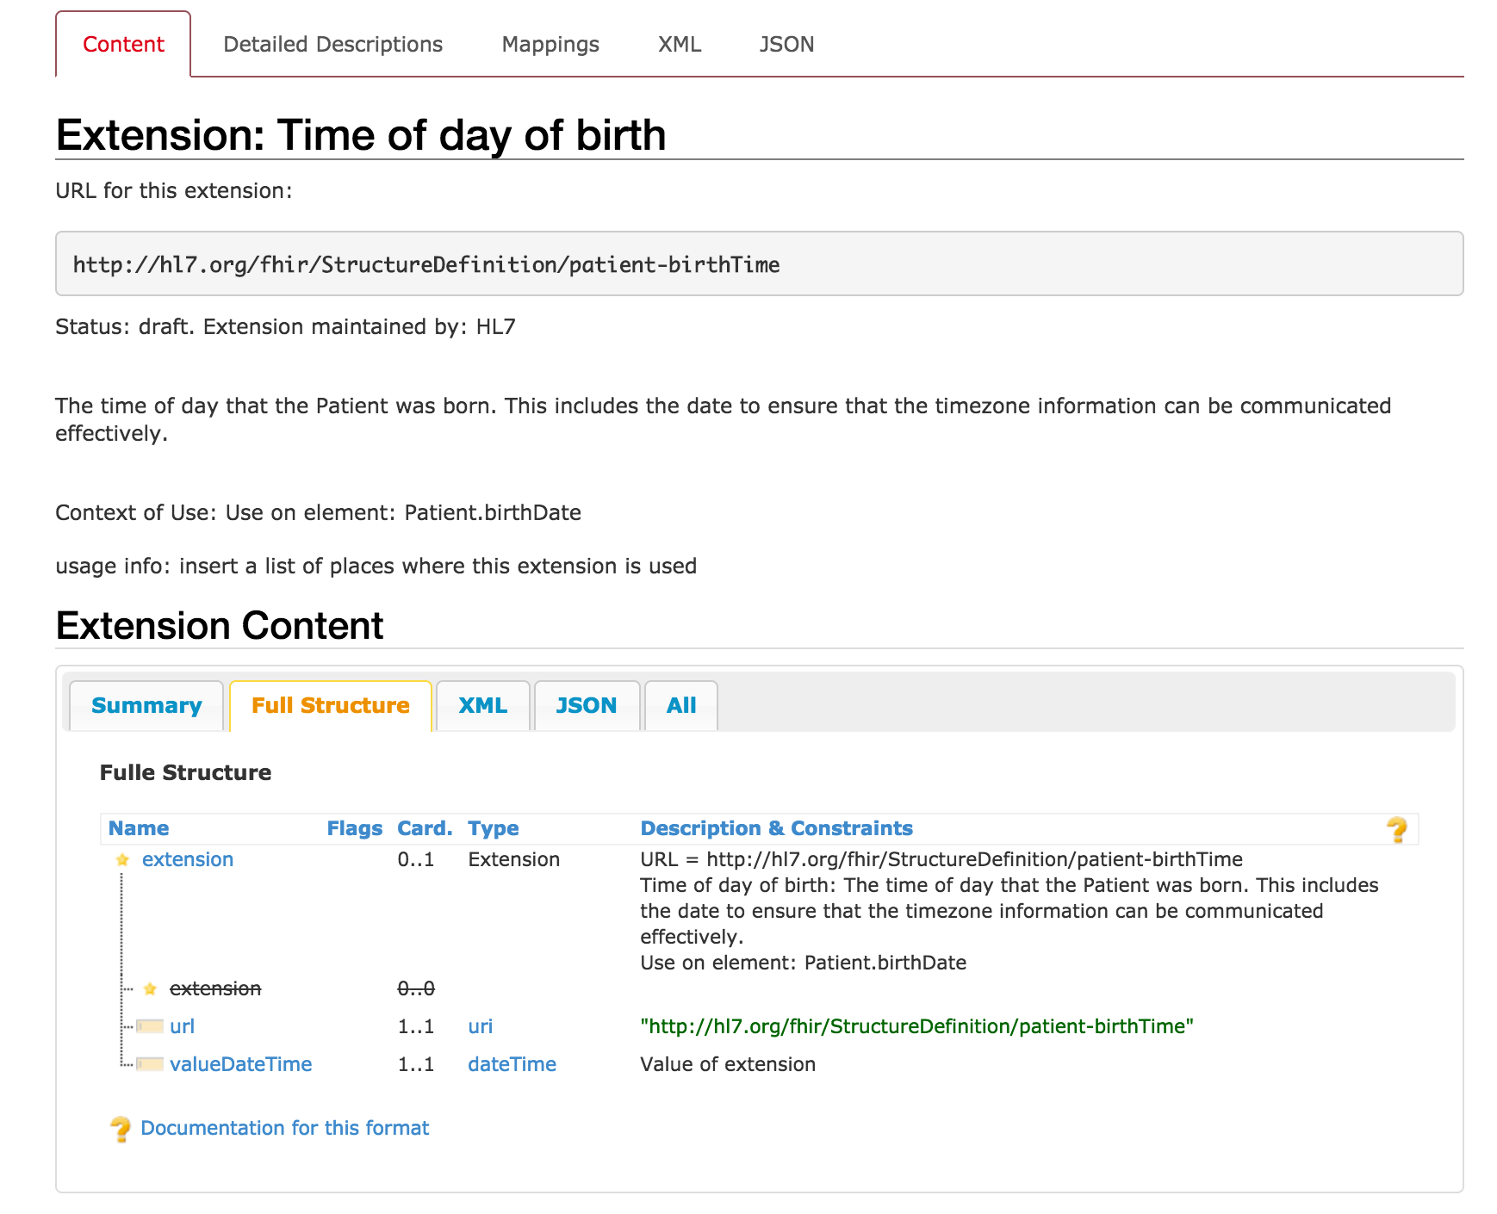
http://hl7.org/fhir/dstu2/extension-patient-birthtime.html
Notes:
Not a modifier
Extension to patient.birthDate

Slide 53
Conformance

Slide 54
Conformance Resource
Weird: located at [base]/Conformance [base]/metadata
Describes the Server
Step towards auto-config
http://hl7.org/fhir/dstu2/conformance.html
Notes:
Can be used to describe other things, like desired implementations or capabilities, we’ll concentrate on describing a FHIR server contract.
Not enough to completely configure, but a step in that direction

Slide 55

What?
Which operations?
Which parameters?
Which formats?
Profiles…
Notes:
It defines a large part of the contract

Slide 56
Profiles

Slide 57
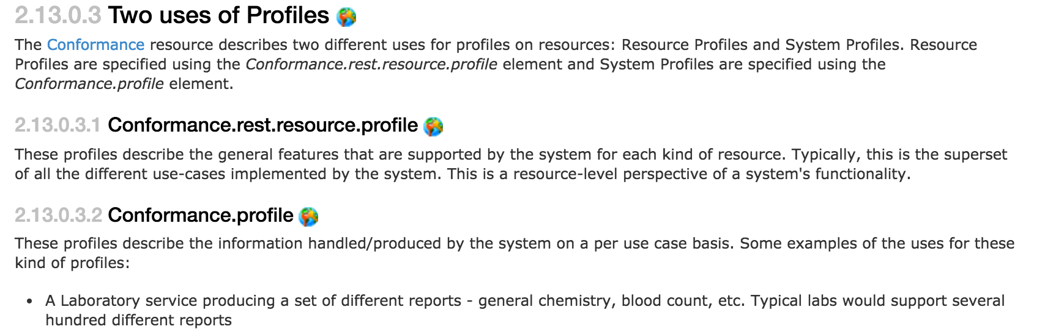
What
http://hl7.org/fhir/dstu2/profiling.html
Notes:
StructureDefinition resource (in DSTU 2)
Detailed description of contracts, per user case or per system

Slide 58
Rules
Detailed contract
Parameters, operations, api calls
Fields, cardinality
Terminology binding, extensions
Must be compatible with core
Can’t change required binding
Cardinality can restrict more (1..* to 1..1 but not 0..*)
Can’t rename fields
Notes:
Compatible: If core binds as required, you can’t change it
If core has 1..*, you can’t change to 0..*, but can change to 1..1
Goal: must be safe to process a resource without the profile

Slide 59
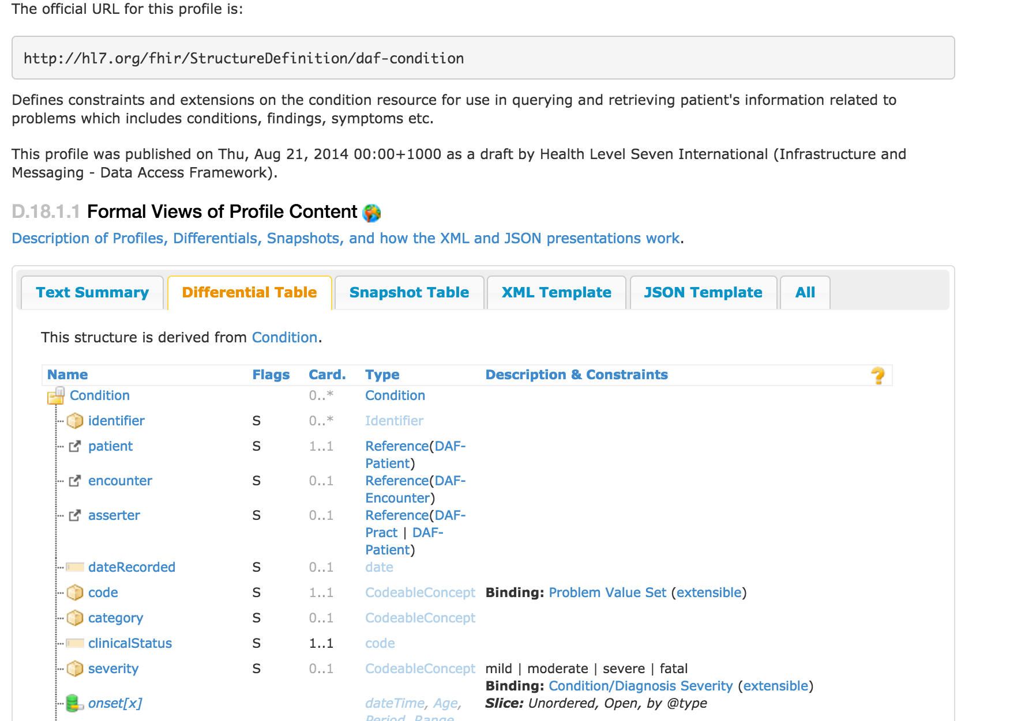
DAF Condition
http://hl7.org/fhir/dstu2/daf/daf-condition.html
Notes:
Part of an Implementation Guide (DAF)
Differential is good at showing differences from core
“Must Support” - it’s fuzzy…
This profile binds Condition.code to a value set, binds severity

Slide 60
Argonaut IG
http://argonautwiki.hl7.org/index.php?title=Main_Page
Linked from FHIR “Implementation Guide” page
Standard Profiles for defined use cases
Address issues from the JASON Task Force reports
http://hl7.org/fhir/dstu2/iglist.html

Slide 61
Questions?

